Slide 1
Dense Video Captioning
Srikumar Brundavanam, Mukul Ganwal, David Ologan, Steven Shi
11.785: Introduction to Deep Learning

Slide 2
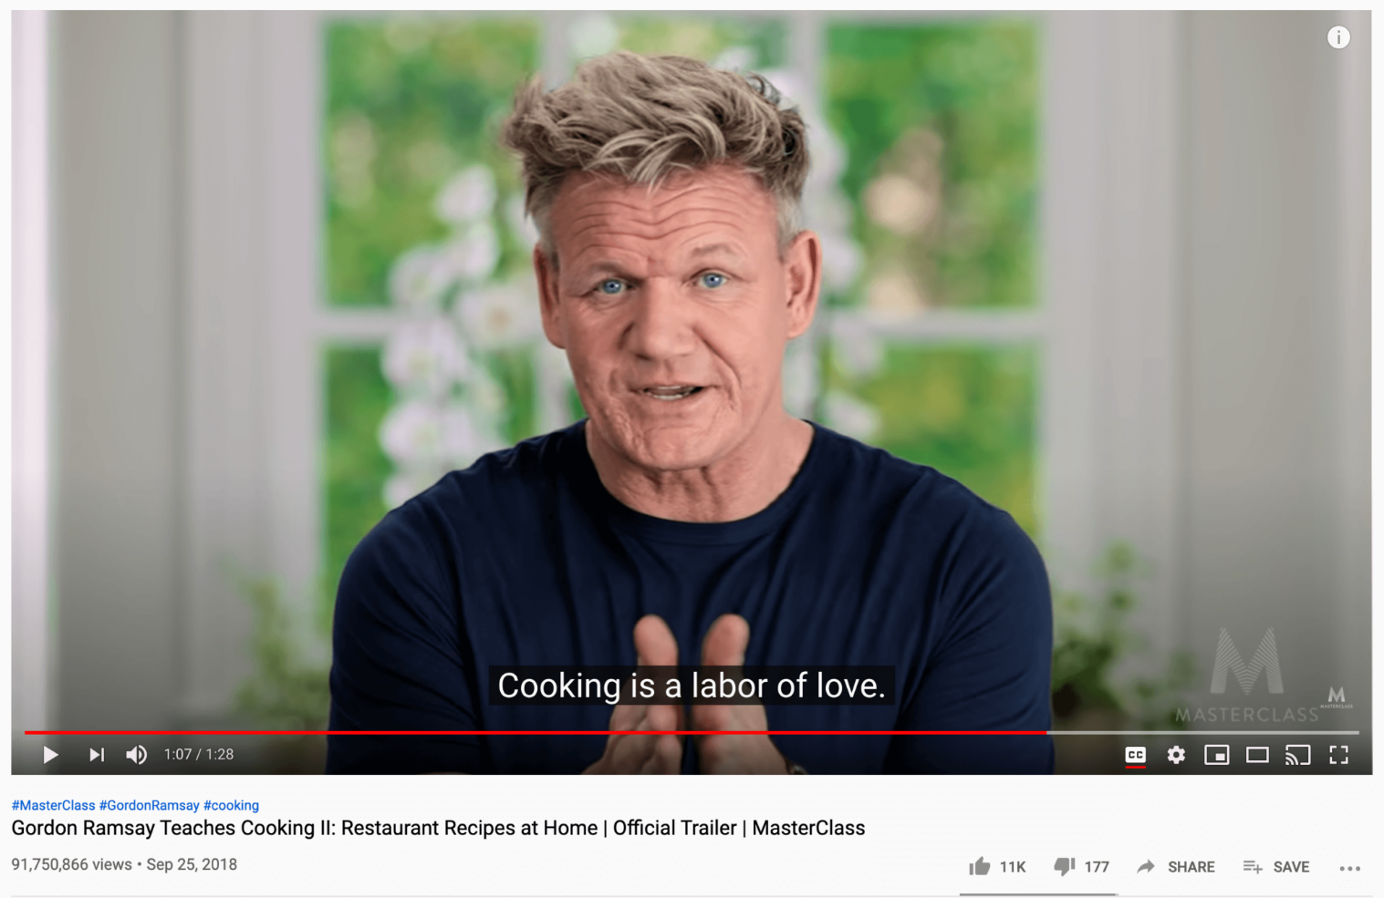
Video Captioning vs Dense Video Captioning
Notes:
aiming to generate a natural sentence to describe one main event of a short video. However, since realistic videos are usually long, untrimmed, and composed of a variety of events with irrelevant background contents, the above single-sentence captioning methods tend to generate sentences of blandness with less information. To circumvent the above dilemma, dense video captioning (DVC) [5, 7, 25, 29, 37] is developed for automatically localizing and captioning multiple events in the video, which could reveal detailed visual contents and generate the coherent and complete descriptions.

Slide 3
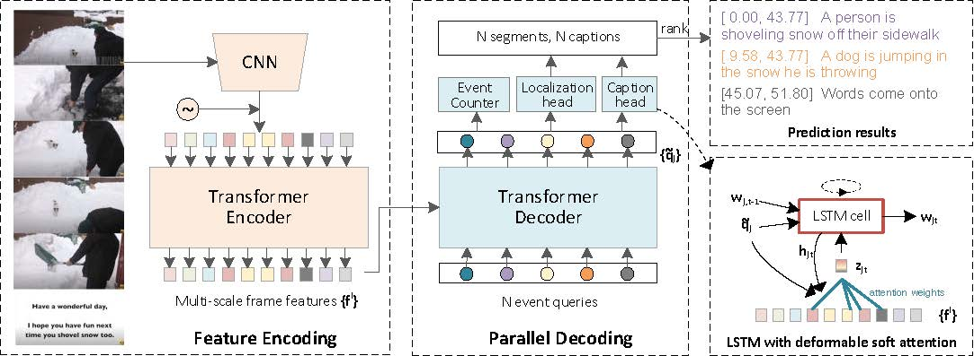
Architecture of Dense Video Captioning With Parallel Decoding (PDVC)
Notes:
It firstly predicts a set of event proposals with accurate boundaries. By extracting fine-grained semantic cues and visual contexts of the proposal, the detailed sentence description is finally decoded by the caption generator.
Issues:
By considering the captioning as the downstream task, the performance of such a scheme highly relies on the quality of the generated event proposals, which limits the mutual promotion of these two sub-tasks.
The performance of proposal generators in previous methods depends on careful anchor design and proposal selection post-processing and These hand-crafted components introduce additional hyper-parameters that highly rely on manual thresholding strategies,

Slide 4
Datasets
ActivityNet | YouCook2
- 20k Videos of Human Activities | - 2k Videos of Cooking Procedures

Slide 5
Video Captions Generated using PDVC

Slide 6
What is Semantic Alignment?
Semantic alignment in video captioning refers to the process of linking different aspects of a video, such as objects, actions, and events, with their corresponding textual descriptions.
Notes:
In video captioning, the aim is to generate a textual description of the content of a video. To achieve this, the video is typically analyzed and segmented into different parts, such as shots or scenes, and each part is described using text. Semantic alignment involves identifying the different visual elements in each part of the video, such as objects and actions, and mapping them to the appropriate textual description.

Slide 7
How do we achieve semantic alignment?

Slide 8
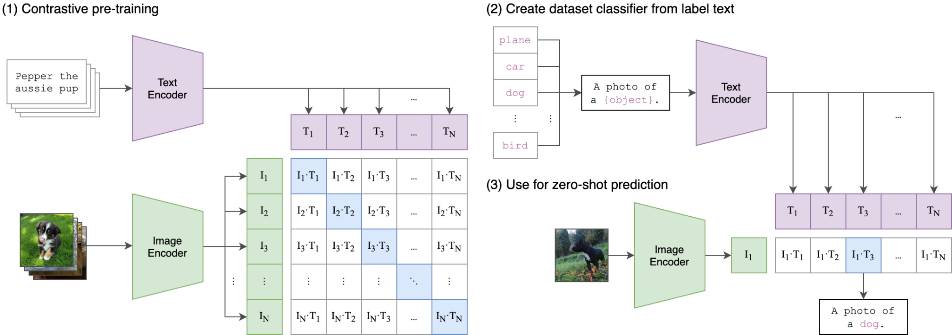
Contrastive Language Image Pre-training (CLIP)
Notes:
CLIP (Contrastive Language-Image Pre-Training) is a neural network trained on a variety of (image, text) pairs. It can be instructed in natural language to predict the most relevant text snippet, given an image, without directly optimizing for the task and is similar to GPt-2 and GPT-3.
CLIP (Contrastive Language-Image Pre-Training) performs semantic alignment between images and their associated text descriptions. The model is trained to learn joint representations of images and text, where the representations are semantically aligned.
While standard image models jointly train an image feature extractor and a linear classifier to predict some label, CLIP jointly trains an image encoder and a text encoder to predict the correct pairings of a batch of (image, text) training examples. At test time the learned text encoder synthesizes a zero-shot linear classifier by embedding the names or descriptions of the target dataset’s classes.

Slide 9
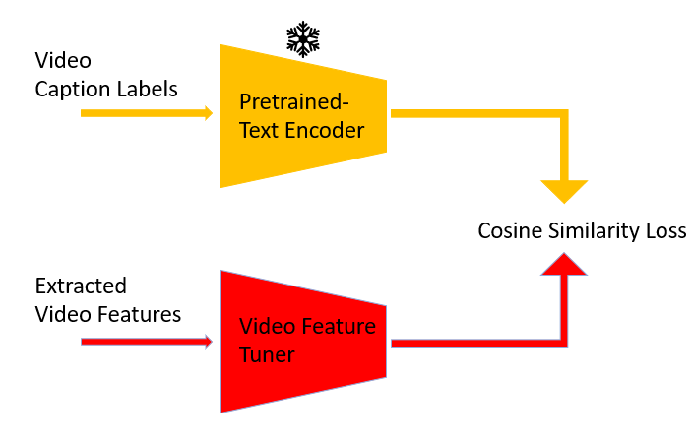
General Idea: Semantic Alignment

Slide 10
How can we use semantic alignment with PDVC?

Slide 11
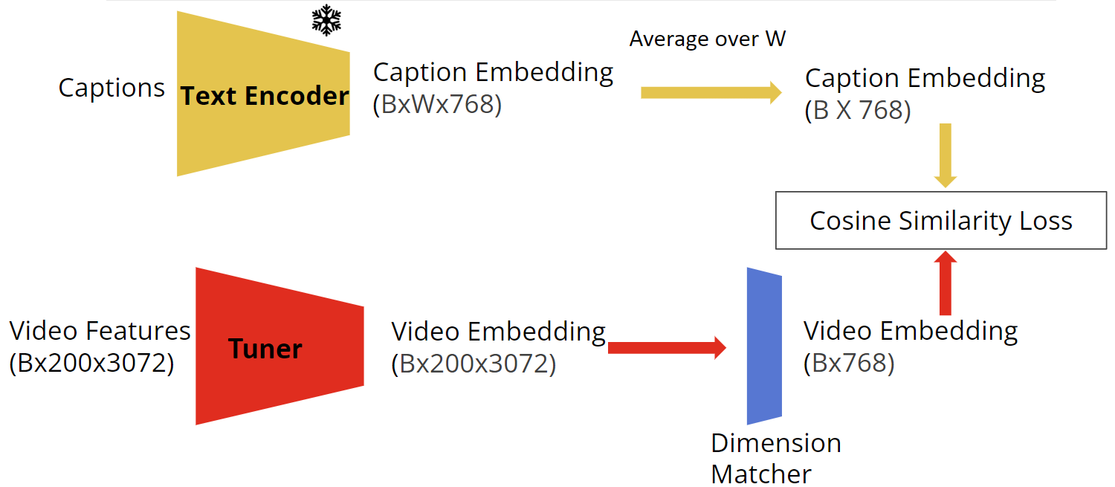
Overall Tuner Training Process

Slide 12
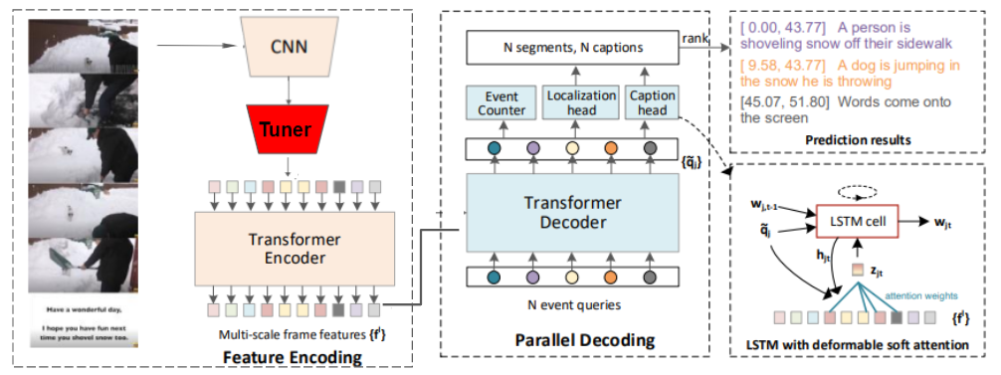

Modified PDVC

Slide 13
How do we evaluate the performance of our model?

Slide 14
Evaluation Metrics
BLEU4 (bilingual evaluation understudy)
Focuses on precision
METEOR (Metric for Evaluation of Translation with Explicit ORdering)
Focuses on both Precision & Recall
CIDEr (Consensus-based Image Description Evaluation)
Focuses on both Precision & Recall
Takes into account sentence structures
SODA_c ( Story Oriented Dense Video Captioning Evaluation)
Focuses on both Precision & Recall
Finds temporally optimal matching between generated and reference captions to capture the story of a video

Slide 15
Tuner Ablations
 | BLEU4 | METEOR | CIDEr | Soda_c
Baseline | 0.76 ± 0.05 | 4.39 ± 0.07 | 20.68 ± 0.21 | 4.47 ± 0.87
Linear | 0.87 ± 0.06 | 4.74 ± 0.09 | 21.76 ± 0.04 | 4.45 ± 1.13
Conv1 | 0.90 ± 0.02 | 4.53 ± 0.07 | 22.32 ± 0.05 | 4.50 ± 1.48
Conv1 w/ linear | 0.77 ± 0.15 | 4.48 ± 0.02 | 21.07 ± 0.92 | 4.47 ± 1.49
Conv2 | 0.40 ± 0.08 | 3.35 ± 0.01 | 14.34 ± 0.02 | 3.53 ± 0.71
Notes:
BELU -> word matching
METEOR -> Work and position matching
Observations
The variance is observed in the data when we running to baseline model and had to get an average and standard deviation to
Cider -> context and understanding metaphor and other non complete sentences.
Soda_c -> Soda is more of a story telling oriented.

Slide 16
Conclusion
Overall, semantic alignment improved the performance of dense video captioning
High variance between metric scores of model
Could be attributed to the small dataset size of YouCook2

Slide 17
Future Work
Train our model on larger more comprehensive datasets like ActivityNet etc.
Could experiment with a variety of Architectures
Currently using CLIP as Text Encoder, others may provide better semantic alignment
Utilize modified PDVC to perform dense captioning on unseen videos

